Slide 1
Understanding and Applying the UAS Pilots Code
Kristy Kiernan, Ph.D.
USI Safety Stand Down
May 1, 2018

Slide 2
Today’s questions
Why does a code of conduct matter?
How can the UAS Pilots Code help you?

Slide 3
Understanding a code of conduct
Links missions, values, and principles to actions
Serves as a guide for day-to-day decision making
Valuable reference material
Externally,
  Compliance
  Marketing
  Risk mitigation

Slide 4
Code of conduct for interactive conference sessions:
Guiding principles:
  Presenter
  Participants

Slide 5
Code of conduct for interactive conference sessions:
Guiding principles:
  Presenter:
    Come prepared
    Be cognizant of time
  Participants
    Engage with the material
    Behave in a professional manner
    Be respectful of others

Slide 6
Code of conduct for interactive conference sessions:
Be respectful of others:
Behaviors:

Slide 7
Code of conduct for interactive conference sessions:
Be respectful of others:
Behaviors:
  listen when others are talking
  do not interrupt
  hear people out before drawing your conclusion
  do not dominate the conversation
  don’t get on your phone
  virtual meetings
    Don’t do other things

Slide 8
Code of conduct for interactive conference sessions:
Research

Slide 9
Code of conduct for interactive conference sessions:
Research
Vet with subject matter experts

Slide 10
Code of conduct for interactive conference sessions:
Research
Vet with subject matter experts
Publicize

Slide 11
Code of conduct for interactive conference sessions:
Research
Vet with subject matter experts
Publicize
Implement

Slide 12
What success looks like…

Slide 13
Purpose and process for the UAS Pilots Code
What are the ethical responsibilities of a UAS pilot?
What are practices that reflect those responsibilities?
What do experts in the field think?
Now we want to get this information out to the field, where you can take it and shape it to fit your organization.

Slide 14
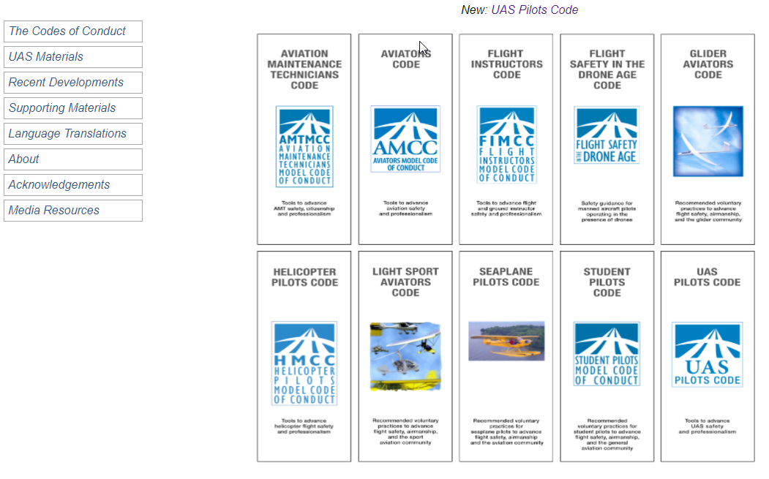
Aviators Code Initiative

Slide 15
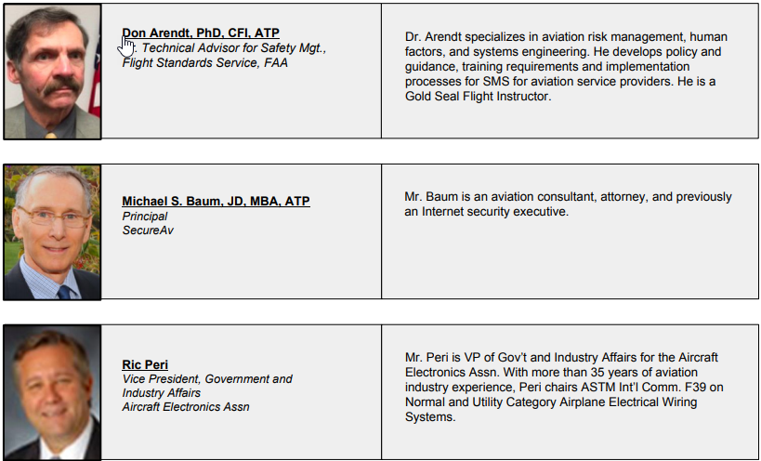
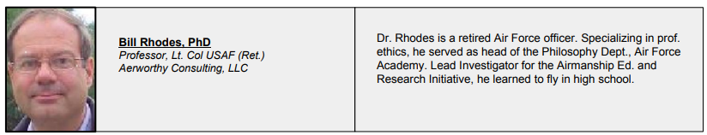
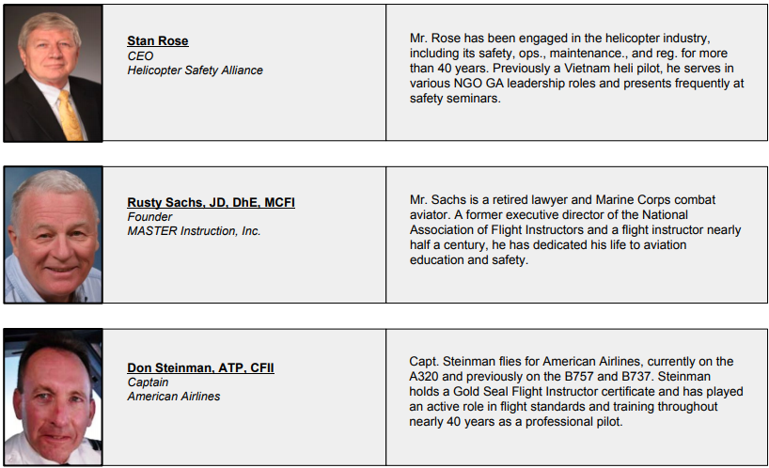
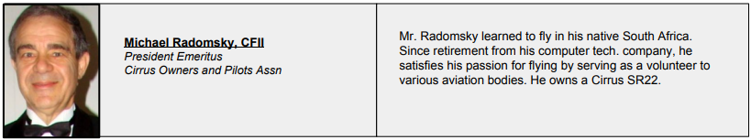
Permanent editorial board

Slide 16

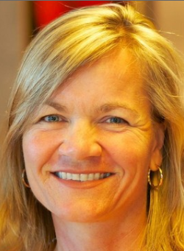
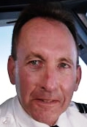
UAS Pilots Code Drafting Team

Slide 17
Sections
General responsibilities of UAS pilots
Manned aircraft and people on the surface
Training and proficiency
Security and privacy
Environmental issues
Use of technology
Advancement of UAS aviation

Slide 18
Sections
General responsibilities of UAS pilots
Manned aircraft and people on the surface
Training and proficiency
Security and privacy
Environmental issues
Use of technology
Advancement of UAS aviation

Slide 19
General responsibilities of UAS pilots
Make safety a top priority
Seek excellence in airmanship (knowledge, skill, ability, and attitude that promote safe and efficient operations)
Adopt sound principles of aeronautical decision-making (ADM) (the process used by pilots to consistently determine the best course of action in response to the circumstances), and develop and exercise good judgment
Use sound principles of risk management
Maintain situational awareness (the accurate perception and understanding of your operation and environment), and adhere to prudent operating practices
Aspire to professionalism
Act with responsibility, integrity, and courtesy
Adhere to applicable laws, regulations, and industry guidance

Slide 20
General responsibilities of UAS pilots
Make safety a top priority
Seek excellence in airmanship (knowledge, skill, ability, and attitude that promote safe and efficient operations)
Adopt sound principles of aeronautical decision-making (ADM) (the process used by pilots to consistently determine the best course of action in response to the circumstances), and develop and exercise good judgment
Use sound principles of risk management
Maintain situational awareness (the accurate perception and understanding of your operation and environment), and adhere to prudent operating practices
Aspire to professionalism
Act with responsibility, integrity, and courtesy
Adhere to applicable laws, regulations, and industry guidance

Slide 21
Make safety a top priority
Recognize, plan for and accept the costs of implementing effective safety practices.
Organizations of any size and scope should apply the principles of a safety management system (SMS): understand the risks in your operations, take steps to control them, and monitor operations to assure that these controls are working.³²
Improve safety margins and reduce unnecessary risk by planning and flying conservatively.
Recognize that use of a visual observer enhances safety, even when not required.³³
Do not carry hazardous payloads unless authorized.³⁴
Do not assume that the altitudes prescribed in UAS Facility Maps are necessarily accurate or appropriate for flight.³⁵
Create an emergency response plan, and implement it in the event of an incident or accident.³⁶

Slide 22
Make safety a top priority
Recognize, plan for and accept the costs of implementing effective safety practices.
Organizations of any size and scope should apply the principles of a safety management system (SMS): understand the risks in your operations, take steps to control them, and monitor operations to assure that these controls are working.³²
Improve safety margins and reduce unnecessary risk by planning and flying conservatively.
Recognize that use of a visual observer enhances safety, even when not required.³³
Do not carry hazardous payloads unless authorized.³⁴
Do not assume that the altitudes prescribed in UAS Facility Maps are necessarily accurate or appropriate for flight.³⁵
Create an emergency response plan, and implement it in the event of an incident or accident.³⁶

Slide 23
Understanding a code of conduct
Links missions, values, and principles to actions
Serves as a guide for day-to-day decision making
Valuable reference material
Externally,
  Compliance
  Marketing
  Risk mitigation

Slide 24
Make safety a top priority
Recognize, plan for and accept the costs of implementing effective safety practices.
Organizations of any size and scope should apply the principles of a safety management system (SMS): understand the risks in your operations, take steps to control them, and monitor operations to assure that these controls are working.³²
Improve safety margins and reduce unnecessary risk by planning and flying conservatively.
Recognize that use of a visual observer enhances safety, even when not required.33
Do not carry hazardous payloads unless authorized.³⁴
Do not assume that the altitudes prescribed in UAS Facility Maps are necessarily accurate or appropriate for flight.³⁵
Create an emergency response plan, and implement it in the event of an incident or accident.³⁶

Slide 25
Endnotes
³² See generally FAA, Safety Management System (SMS), https://www.faa.gov/about/initiatives/sms/; ICAO, Manual on RPAS, Ch. 7.4.1 (requirement to implement a SMS); and ICAO, Safety Management Manual, Doc. 9859, AN/474, ch. 5 (3rd ed. 2013), https://www.icao.int/safety/SafetyManagement/Documents/Doc.9859.3rd%20Edition.alltext.en.pdf (Safety Management Systems).

Slide 26
Website: secureav.com

Slide 27
Website: secureav.com

Slide 28
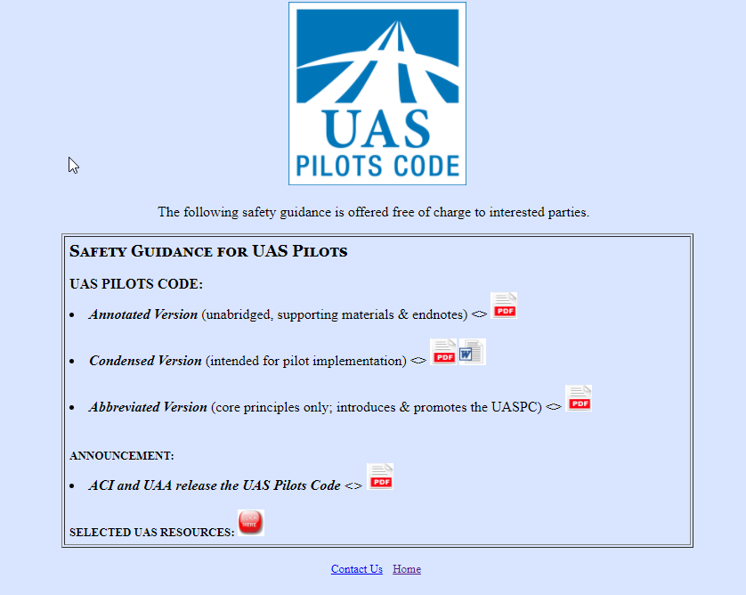
Principles, recommended practices, drafting considerations, and end notes. 110 pages.
Condensed version: Principles, recommended practices. 15 pages.
Principles only. 1 page.

Slide 29
Website: secureav.com

Slide 30
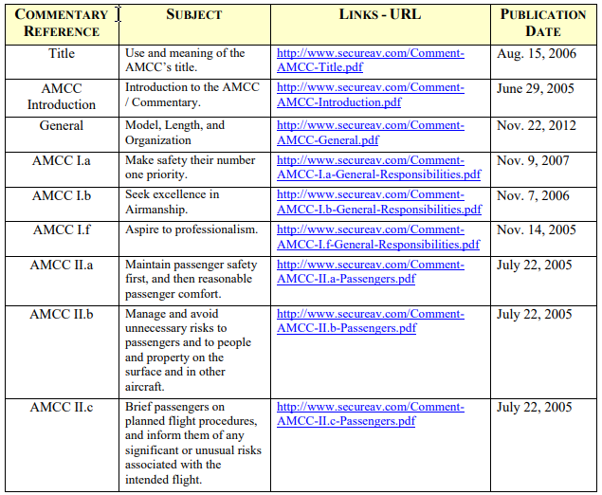
Supporting materials

Slide 31
Supporting materials

Slide 32
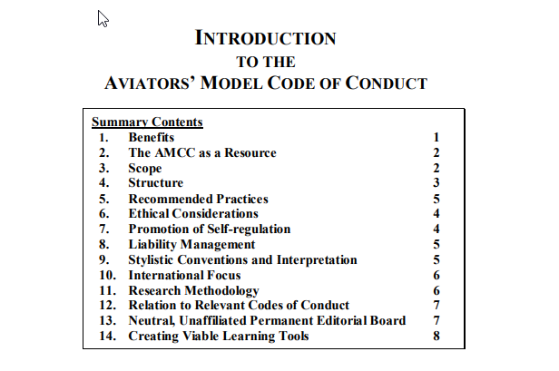
AMCC Introduction

Slide 33
Reviewers
Rex Alexander, Head of Aviation Infrastructure, Uber Technologies, Inc.
Tim Bean, CEO, Fortum Technologies
Fred Borda, Co-founder, COO, Aerial Innovation, LLC
Amanda Brandt, Assistant Professor and Chief UAS Pilot, University of North Dakota
John Bridewell, EdD, Professor of Aviation, Univ. of North Dakota
Amanda Briggs, Flight Instructor, Inst. of Aviation, Parkland College
Tim Bruner, UAS Researcher, Kansas State Polytechnic
Scott S. Burgess, PhD, CFI/IP, RPC, Associate Professor, ERAU-Worldwide
Kendell Clutts, Flight Validation Lead, GoPro Inc.
Linda Connell, Dir., Aviation Safety Reporting System, NASA
Chris Covell, Flight Operations Manager, GoPro Inc
Michael L. Dworkin, Esq., Avialex
Paul Duty, CFI, CFII, MEI, AGI, Aviation Instr., Aviation Marketing Specialist, Gleim
Patrick Egan, Managing Partner, sUAS News
Tom Farrier, Clancy Int’l, CTR, Prin. Safety Analyst, FAA Emerg. Tech. Team (AJV-115)

Slide 34
Reviewers
Nicholas T. Flom, Exec. Dir., Northern Plains Unmanned Aircraft Systems Test Site
Michael Gadd (FRAeS), Policy Lead, UAS, Civil Aviation Authority (UK)
John T. Van Geffen, Esq., Avialex
David Graves, Founder and CEO, SkyVector
Rich Hansen, President, Academy of Model Aeronautics
Brad Hayden, President & CEO, Robotic Skies
Becky L. Hooey, PhD, Human Systems Integration Div., NASA Ames Research Center
David Ison, PhD, Editor-in-Chief, IJAAA; Asst. Prof. of Aeronautics, ERAU; Pres., UAA
Kenneth Kelly, FAA, Airworthiness FPM/POC sUAS Ed. Outreach, SPPO, AFS-920
Parimal Kopardekar (“PK”), Sr. Tech. Air Transport, Auton. Expert, Co-EIC, JAO, NASA
Christopher T. Kucera, Director, Air Operations, Analytical Graphics, Inc.
Tracy Lamb, VP, Reg. & Safety Affairs-Chief Pilot, AUVSI
Leonard Ligon, Corp. Lead; Global UTM, WhiteFox Defense Group
John Marselus, DDiv, Director of Aviation, San Diego Christian College
Douglas M. Marshall, Esq., Principal, TrueNorth Consult. LLC; Adj. Prof., De Paul C.o.L.

Slide 35
Reviewers
Frank Matus, Dir., Strategy & Business Development, Thales
Nick Mayhew, Senior Program Manager, L3 Link Training & Simulation
Mary Mikolajewski, Manager, Technical Committee Operations, ASTM Int’l
Brandon Montellato, University Relations Manager, DJI
David Morss, ATP, Test Pilot, Reno Air Races Pilot
Jorge B. Moya, ASRS, NASA Ames; Booz Allen Hamilton, Inc.
R. Lance Nuckolls, FAA, Aviation Safety Inspector
Frank Paskiewicz, VP - Production and Airworthiness, Padina Group, Inc.
Kuldeep S. Rawat, PhD, Dep’t Chair, Dir. of Aviation, Elizabeth City State University.
Timothy Reuter, Civil Drones Project Head, World Econ. Forum
John Robbins, PhD, Assistant Professor, ERAU
Fred Roggero, President and CEO, Resilient Solutions, Ltd.
Wes Ryan, Mgr., Advanced Technology Branch, FAA
Confesor Santiago, III, Aerospace Engineer, Ames Research Center
Karl Schweikert, Esq., AV8 Law Group

Slide 36
Reviewers
Jackie Spanitz, General Manager, Aviation Supplies & Academics (ASA Inc.)
Tyler Spence, PhD, Assistant Professor, Dep’t Avi. & Tech., San Jose State University
Werner von Stein, Founder, SF Drone School
Walter Stockwell, Director of Technical Standards, DJI
Scott Strimple, Chief Flight Instructor, Drone Flight School
Joseph J. Vacek, JD, Assistant Professor of Aviation. University of North Dakota
John Scull Walker, Senior Partner, Padina Group; Chair, ISO TC 20/SC 16
Reiner von Weber, Founder, SF Drone School; STEAM Capt., X Class Drone Racing L
Gretchen West, Sr. Advr., Hogan Lovells US LLP; Co-Exec. Dir., Comm. Drone Alliance
Ted Wierzbanowski, Immediate Past Chair, ASTM Int’l, Committee F38
Michael Wiggins, EdD, MBA, Professor and Depart. Chair, Aeronautical Science, ERAU
Heidi Williams, Dir., Air Traffic Services & Infrastructure, NBAA
Randy Willis, Manager, FAA ATO, Emerging Technologies Team
Harrison Wolf, Project Lead, World Economic Forum
Gilead Wurman, PhD, CFI, Senior Seismologist and UAS Program Mgr., ENGEO

Slide 37
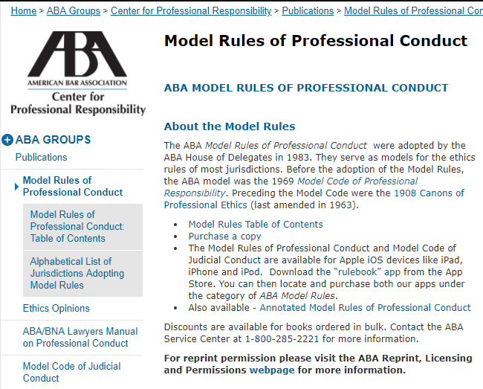

Slide 38
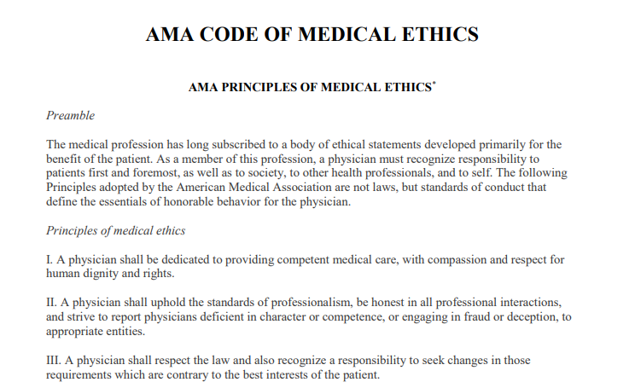

Slide 39
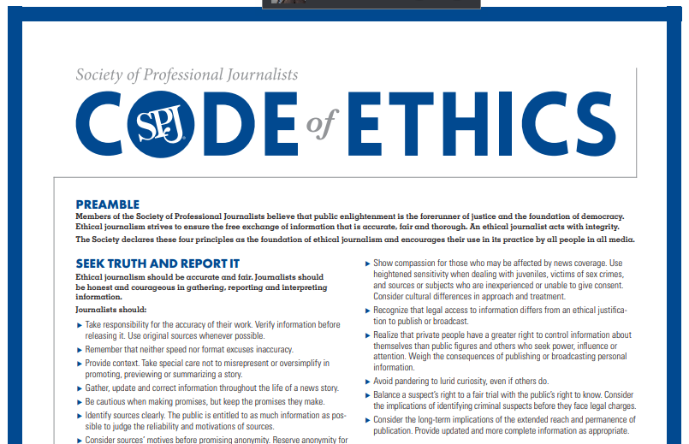

Slide 40
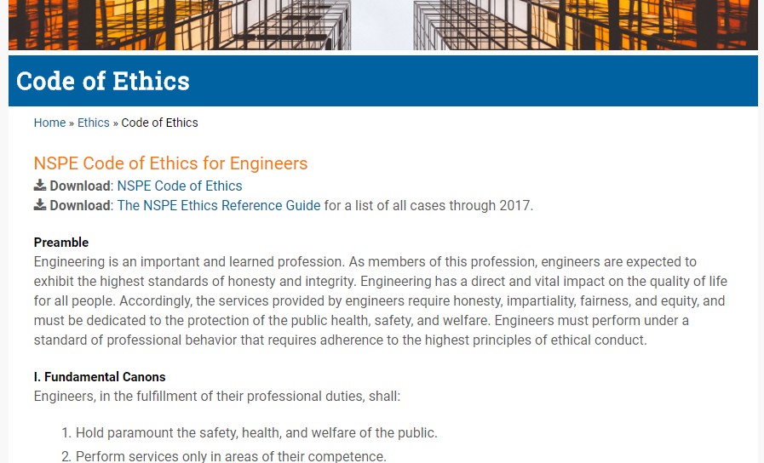

Slide 41
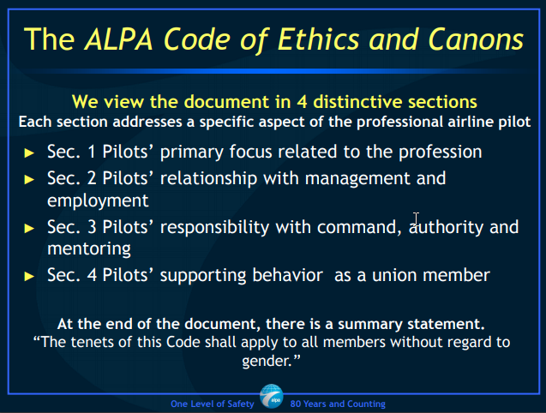

Slide 42
Today’s questions
Why do codes of conduct matter?
How can the UAS Pilots Code help you?

